Slide 1
Infection Prevention in the Dental Setting 2016
Joyce A. Moore RDH, BSDH
Compass Dental Safety
Adjunct Clinic Instructor of Dental Hygiene
Bristol Community College

Slide 2
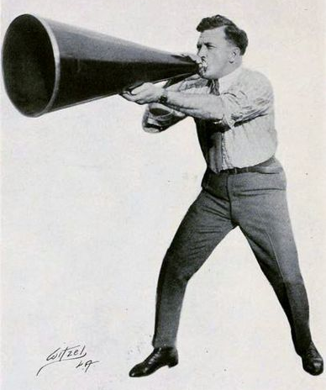
Disclaimer
Joyce A. Moore is the owner of Compass Dental Safety and an employee of Bristol Community College.
Neither I nor any of my immediate family have any financial relationships with commercial entities that may be relevant to this presentation.
Notes:
Hello everyone! Today I’m going to talk to you about IP. Please write any questions you might have on the index card you received and I’ll do my best to address them at the end.

Slide 3
Course Objectives
Identify agencies and credible resources for infection prevention
Describe the basic concepts and principles of infection prevention
Discuss the components of an infection prevention plan for providing safe patient care in the dental setting
Evaluate current infection control policies, procedures and products

Slide 4
A number of conditions must be met for disease to be transmitted
Infectious Agent
Source
Hygienist
Mode
Cough
Portal
Lungs
Host
Elderly Patient
Chain of Infection
The purpose of infection control is to break the chain!
Notes:
Pathogen – is an infectious substance that is capable of causing disease such as bacteria + viruses, and must be present in sufficient numbers. It needs
A reservoir where it can reside + multiply, such as the blood stream or mucous membranes
A mode of transmission from the source host. This can be a splash, the inhalation of contaminated aerosols or needlestick
A proper portal in to the new host– for example a BBP must have a way to enter the bloodstream, such as a break in the skin
The new host must be susceptible to the pathogen. If has had vaccine or has prior exposure to the pathogen that resulted in immunity, exposure will not result in disease.

Slide 5
Modes of Transmission
Direct contact - blood or bodily fluids
Indirect contact - contaminated instrument or surface
Contact of the eyes, nose or mouth with droplets or spatter
Inhalation of airborne microorganisms
CDC.gov
Notes:
Direct Contact – with blood or bodily fluids
Indirect Contact – with a contaminated instrument or surface
Contact - of mucosa of the eyes, nose or mouth with droplets or spatter
Inhalation – of airborne microorganisms

Slide 6
Disease Transmission in Dentistry
Notes:
Disease can be spread from DHCP to pt, pt to pt, and pt to DHCP

Slide 7
Government Agencies Involved
Notes:
As you can see, there are many agencies involved in infection control. The FDA, who regulates medical devices (gloves, sterilizers etc.), the EPA, who regulates chemicals and issues guidelines and regulations for management of waste and NIOSH who …… The agencies most everyone associates with infection control though, are the CDC and OSHA.

Slide 8
OSHA’s Role
OSHA protects workers
1970 Congress passed the Occupational Safety and Health Act
Is a regulatory agency that enforces legal standards ($$$)
Known for -
Bloodborne Pathogens Standard (BBP)
Hazard Communication Standard (aka Employee Right to Know)
General Duty Clause – work place safe from serious hazards, cites requirements for exits routes and electrical standards
Notes:
OSHA ‘s role is to protect the safety and health of America’s workers by establishing and enforcing legal standards that encourage occupational safety and health.
All employers and employees in the US and it’s territories must comply or face jail time or monetary penalties. OSHA poster must be posted
10 most frequently cited OSHA standards – BBP, Haz-com, PPE, maintaining exit routes, first aid / med services (eye wash station)

Slide 9
CDC’s Role
It is the nation’s premier public health agency
No regulatory authority
CDC produces IC guidelines, specifically the Guidelines for Infection Control in Dental Health-Care Settings–2003, which are considered the standard of care and have been adopted by many state dental boards
Tells us what DHCP should do

Slide 10
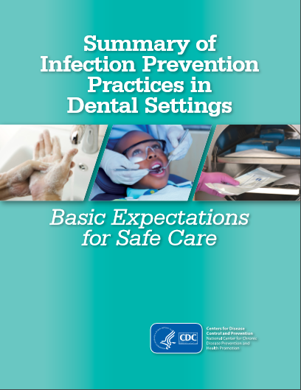
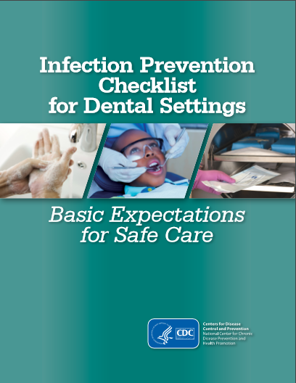
2016 CDC Summary
Notes:
Like peas and carrots go together the CDC released these documents earlier this year. They focus on key CDC recommendations from the Guidelines for Infection Control in Dental Health-Care Settings–2003, but IT’S NOT a replacement that document. It is by no means a comprehensive document and it is not a summary of regulations
What You Will Get From the Summary and Checklist:
Six fundamental elements needed to prevent transmission of infectious agents
Key CDC recommendations
Current CDC recommendations from the Guidelines for Infection Control in Dental Health-Care Settings–2003
Additional topics, recommendations and information published since 2003
Assessment checklists to evaluate prevention practices

Slide 11
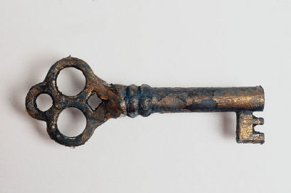
6 Key Recommendations
Administrative Measures
Infection Prevention Education and Training
Dental Health Care Personnel Safety
Program Evaluation
Standard Precautions
Dental Unit Water Quality

Slide 12
Administrative Measures
Written infection prevention (IP) policies and procedures specific for the dental setting are available, current and based on evidenced based guidelines, regulations or standards
IP policies and procedures are reassessed and updated if appropriate, at least annually or according to state/federal requirements
At least one person trained in IP is designated the Infection Control Coordinator (ICC) and is responsible for the IP program
Notes:
Administrative measures are like a car. Written IP policies are like an owner’s manual, but with the updates you get from the dealer. Cars need maintenance and you have to follow state or fed rules, like getting a sticker. One person trained is like the car owner, someone who knows how it works. Supplies necessary for SP are like the seatbelt etc. Early detection system is like a Dad not letting an overtired teenager drive.

Slide 13
Administrative Measures
Supplies necessary for adherence to Standard Precautions are readily available, including hand hygiene products, personal protective equipment (PPE) and safer devices to reduce percutaneous injuries
The facility has a system for early detection and management of potentially infectious persons at the initial points of patient encounter and may include taking a travel and occupational history and elements of respiratory hygiene / cough etiquette
Notes:
Readily = right there and ready to go

Slide 14
Infection Prevention Education & Training
DHCP receive job/task specific training on IP policies & procedures and the OSHA BBP Standard. Record of trainings are maintained.
Upon hire
Annually
When new tasks or procedures affect the employee’s occupational exposure
According to state or federal regulations
Note: this includes employee of outside agencies and available by contract or on a volunteer basis

Slide 15
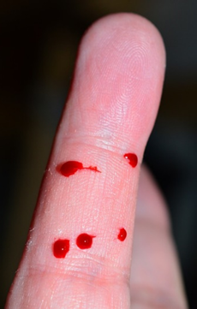
Dental Health Care Personnel Safety
Clear, written policies & procedures and education of DHCP
Referral & access to clinical care by a qualified health care professional to ensure prompt and appropriate medical services
Well defined policies concerning personnel that may have transmissible conditions including work exclusion polices
Notes:
Occupational health program of a hospital, educational institutions, HC facility that offer personnel health services.
Policies that educate personnel on importance of and encourage reporting of illness and don’t penalize staff w/loss of wages, benefits, or job status.

Slide 16
CDC Work Restrictions
Respiratory Virus
Conjunctivitis
Diarrhea
Measles
Pertussis
Strep Group A
Varicella
Shingles/Zoster
Until symptoms stop
Until no discharge
Until symptoms stop
About one week
5 days after antibiotics
24 hrs. after antibiotics
Until lesions crust
Cover lesions
www.cdc.gov/hicpac/pdf/InfectControl98.pdf
Notes:
Go over slide

Slide 17
CDC Vaccine Recommendations
A written policy for immunizations, evaluation and follow up -
Hepatitis B
MMR – Measles, Mumps & Rubella
Influenza
Tdap – diphtheria, tetanus & pertussis
Varicella – chickenpox
Flu
Tb screen upon job hire
www.cdc.gov/vaccines/adults/rec-vac/hcw.html
www.cdc.gov/mmwr/preview/mmwrhtml/rr6007a1.htm
Notes:
MMR is recommended for persons born after 1957 w/out serological evidence of immunity or prior vaccination
Tetanus, diphtheria, pertussis – all HCW need Td booster after 10 years (workers under the age of 65 w/direct pt contact should receive a 1 time IM dose TDAP
Varicella – no proof of immunity, prior vaccination or history of disease

Slide 18
Hepatitis B Vaccine
Made available by the employer :
No cost to employees and at a reasonable time/place
Within 10 working days of initial assignment
Post screening 1-2 months after completion of 3 dose series to check protective level of surface antibody
Exceptions:
Previously vaccinated or antibody testing reveals immunity
*Must have proof of series or declination on file*
Notes:
If after testing, antibodies are present the team member is immune. If there is no antibody response then the team member should complete a second 3 dose series. If no response happens after the 2nd 3 dose series, the non responder should be tested to determine if he/she is a carrier. 95% of healthy, properly vaccinated young adults develop protective antibodies to the virus. Protection lasts at least 15 years. Boosters are not recommended at this time.

Slide 19
Bloodborne Diseases
Hepatitis B HBV
Greatest risk for DHCP
A liver disease – over 1 million infected
Hepatitis C HCV
Virus that causes AIDS
Virus survives 7 days outside body
Highly infectious, carrier may be asymptomatic
Low rate of dental transmission – no cases since 2001
NO VACCINE
HIV
NO VACCINE
Virus can remain on dry surface for 6 wks.
A liver disease – can be infected for up to 20 yrs without symptoms
Virus cannot survive long on a surface
Vaccine available
Notes:
Dental team members work in close contact with blood and blood contaminated saliva, putting them at a risk of exposure to BBPS. These are transmissible in health care setting, can produce chronic infection and are often carried by persons unaware of their infection. Hep B is our biggest concern. (Read info on slide) Hepatitis C is a chronic disease linked to illegal drugs, blood transfusions prior to 1992 and long term kidney dialysis. CDC recommends that anyone born between 1945-1965 be tested.

Slide 20
30% = chance of contracting Hepatitis B if exposed and non immune. (Get vaccinated!!!)
1.8%= risk of HCV infection after a needlestick or sharps exposure to HCV-positive blood.
.3 % = chance of infection if exposed to the HIV virus.
Notes:
Go over slide

Slide 21
Post-exposure Management
Wound management – soap & water, no bleach, flush mucous membranes
Immediate exposure reporting
Mandated, no negative consequences
Source patient testing rapid HIV, Hep B & C (can decline)
Employee baseline testing & counseling including post exposure testing
Accident report / Exposure log kept
Notes:
Although IC precautions are highly effective when used routinely, accidents can happen. When sharps injuries or unexpected spills or splashes to non intact skin or mucosa occur, tend to them immediately. Exposure incidents are medical emergencies. Prompt evaluation & treatment helps give the best chance of avoiding infection.
Exposure report – date, time, procedure details (when, where, how, what device), exposure details, DO NOT put exposure report in pt’s chart.

Slide 22
Program Evaluation
IP program success depends on -
Routine program evaluation, including evaluation of DHCP adherence to IP practices
Developing standard operating procedures
Documenting adverse outcomes & work related illnesses in DHCP
Healthcare Acquired Infection patient monitoring

Slide 23
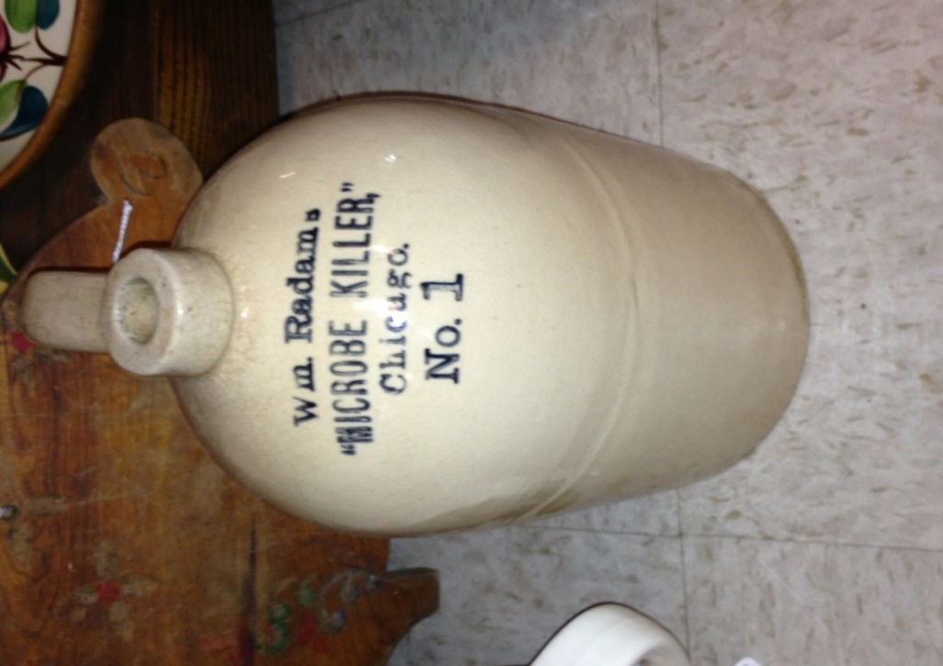
Standard Precautions
Minimum IP practices that apply to all patients, regardless of health history
All body fluids are considered infectious except sweat
These practices protect DHCP and prevent DHCP from spreading infections among patients.
Notes:
Standard precautions are a cornerstone of dental infection control, that encompasses a set of IC & safety procedures to protect against bloodborne disease transmission.

Slide 24
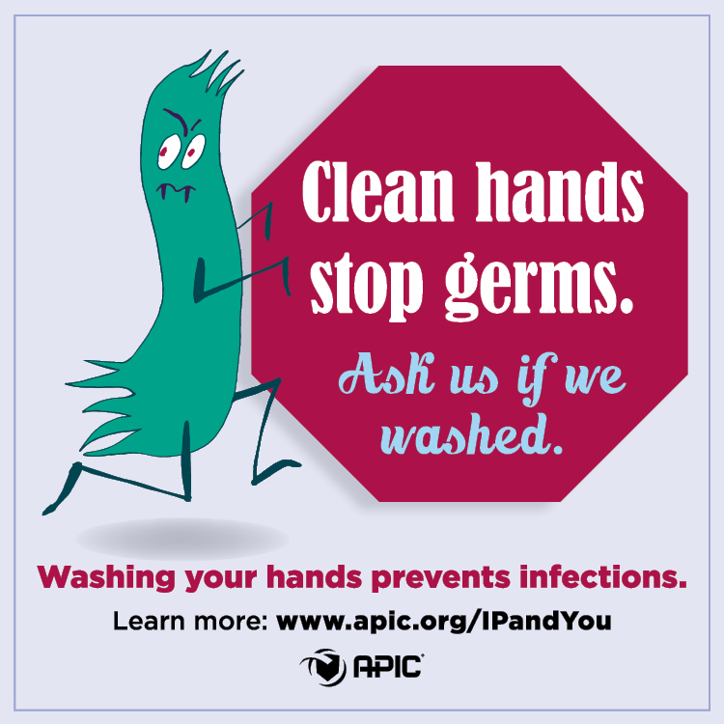
Elements of Standard Precautions
Hand Hygiene
Personal Protective Equipment
Respiratory Hygiene/Cough Etiquette
Sharps Safety
Safe Injection Practices
Sterilization/Disinfection
Environmental IP & IC

Slide 25
Hand Hygiene
#1 way i disease transmission
Average of 40% L = 34 studies
Skin flora i by washing for 20 seconds with warm (not hot) water and regular/ antimicrobial hand wash
Alcohol based hand rub (60 -95%) for 15 seconds if no visible soil
Dry well with paper or clean towel
Non petroleum hand cream is OK
GLOVING IS NEVER A SUBSTITUTE!
CDC.gov

Slide 26
CDC says

Slide 27
When?
Hands are visibly soiled
After touching contaminated objects
Entering the operatory
Before gloving + after removal
Before leaving the operatory
Before eating
After using the restroom
cdc.gov
Notes:
This is a very comprehensive list of WHEN you should wash your hands. If you are using liquid soap it should be stored in a closed container that can either be washed and dried before refilling or are disposable. Don’t top off a partially empty container.

Slide 28
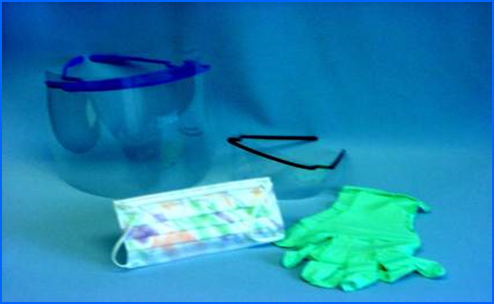
Personal Protective Equipment
cdc.gov
Specialized clothing or equipment worn by the employee for protection against infectious materials
OSHA says employers must –
Provide PPE that is sufficient, appropriate and readily available
That DHCP get training on proper selection and use
It is disposable or cleaned, laundered & stored after use
PPE should be removed when leaving treatment areas
Notes:
PPE must be sufficient, appropriate and readily available

Slide 29
Apparel
Covers skin + uniform
High neck
Long sleeves
Cover to the knees
Change ASAP if penetrated by blood or body fluids or visible soil
Remove all PPE before leaving the work area
Uniformadvantage.com

Slide 30
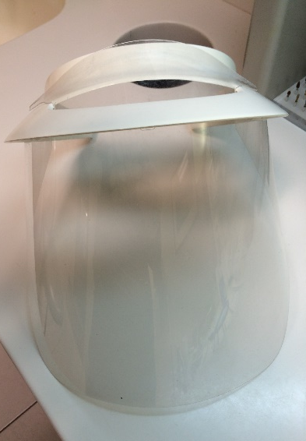
Masks & Face Shields
Fit to limit fogging
Light seal to protect nose + mouth
New between pts, wet or compromised
95% filtration
Worn with face shield + eyewear
Face shield covers forehead, extends below chin + around the side of face. Clean and disinfect if visibly soiled

Slide 32
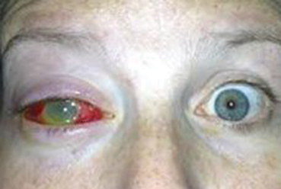
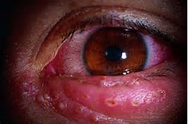
Eyewear
Jenn’s Vision
ANSI approved
Impact resistant
Side protection
Patient use (Jenn’s Vision)
Particles can fly at 50 MPH!
Soap and water or mid level disinfectant to clean
www.lasikeyesurgeryhawaii.com
Notes:
American National Standards Institute. Handpieces can have a rotation speed of 180,000 to 500,000 times per minute

Slide 33
Gloves
Size, task & material appropriate
Exam – change & wash hands if torn, cut or punctured. No washing gloves!
Surgical–sterile
Over–cover
Utility–housekeeping
Allergies or contact dermatitis?
Short fingernails (not artificial)
Limit hand or nail jewelry

Slide 34
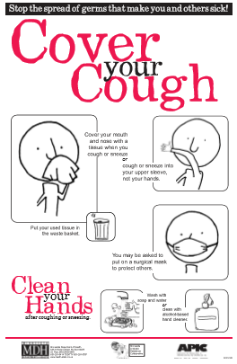
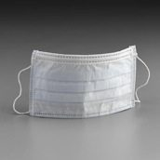
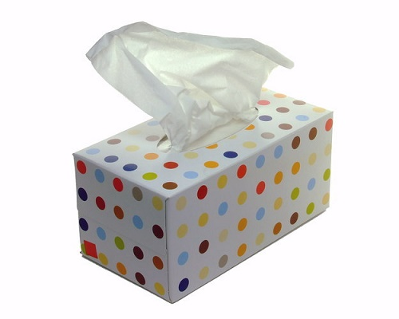
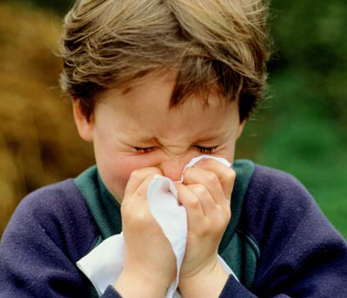
Respiratory Hygiene/Cough Etiquette
Policies & procedures to contain respiratory secretions in potentially infectious people from the time they enter the dental setting
Posting of instructional signs
Tissues & a no-touch receptacle for disposal
Resources for hand hygiene
Face masks for patient use

Slide 35
Sharps Safety
DHCP trained on the use and disposal of sharps
Dispose of sharps ASAP, as close as possible to area of use
Sharps containers are disposed of per fed, state & local rules
Use one handed technique

Slide 36
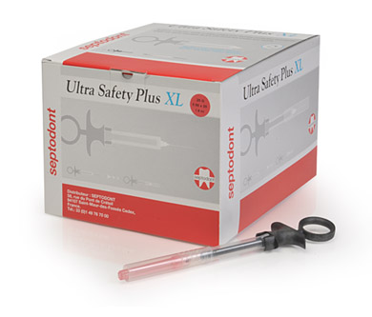
Sharps Safety
Septodont.com
Devices with engineered safety features must be identified, selected and evaluated annually or upon entry to the market by DHCP
The items are used by non-managerial staff
Signed screening and evaluation forms kept on file
Device screening/evaluation forms can be found at www.cdc.gov/oralhealth/infectioncontrol/forms.htm
Southmedic.com

Slide 37
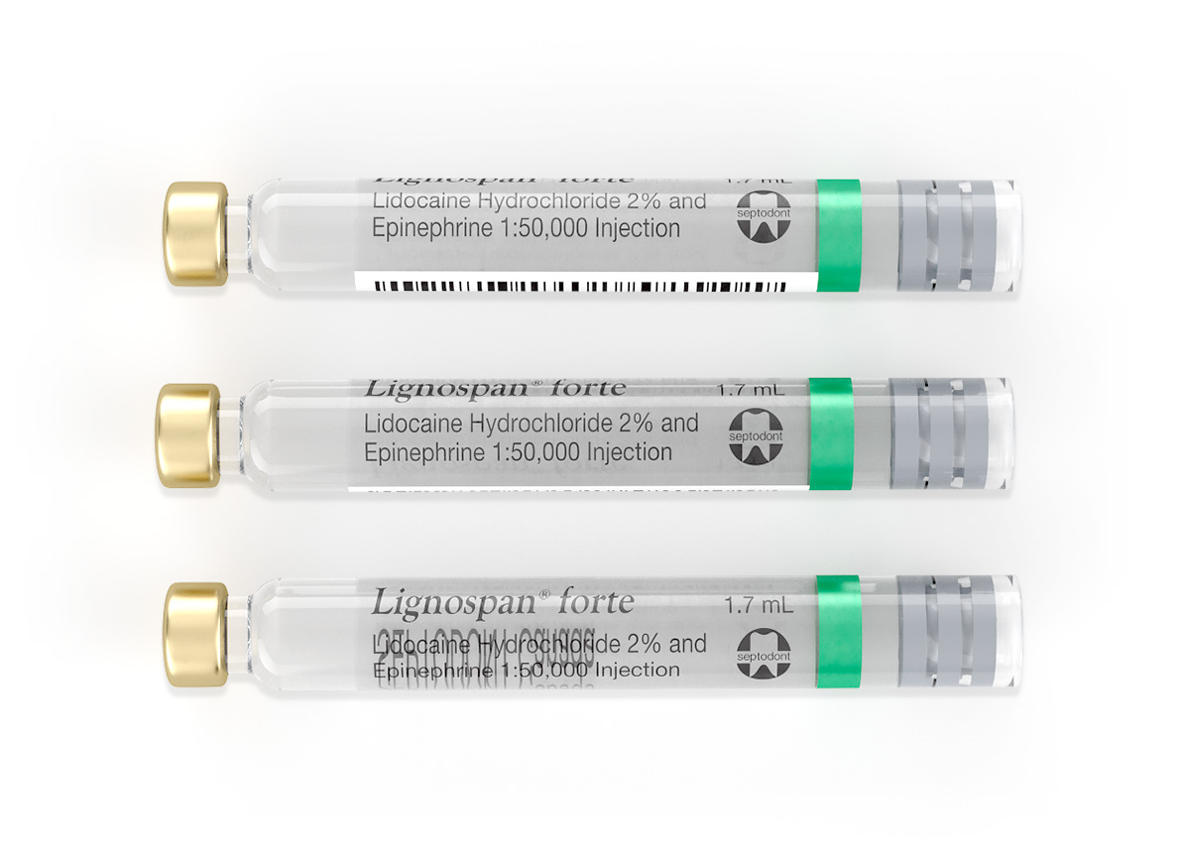
Safe Injection Practices
www.septodontusa.com
ONEandONLYcampaign.org
Notes:
Needles and syringes are only used for 1 pt. The rubber septum on a medication vial is disinfected with alcohol before piercing. The One & Only Campaign is a public health campaign, led by the Centers for Disease Control and Prevention (CDC) and the Safe Injection Practices Coalition (SIPC),

Slide 38
Sterilization & Disinfection of Patient-Care Items & Devices
Chemical
Heat
Sterilization
Notes:
An item is either sterile or it’s not.

Slide 39
Instrument Cleaning
Cleaning types -
Hand scrubbing with a long handled brush Ineffective, inconsistent, injury prone
Automatic –
ultrasonic
instrument washer
washer-disinfector
Dentalaegis.com
Notes:
Cleaning is the most important step!

Slide 40
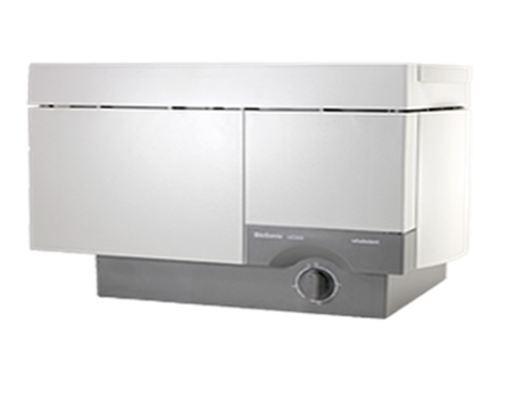
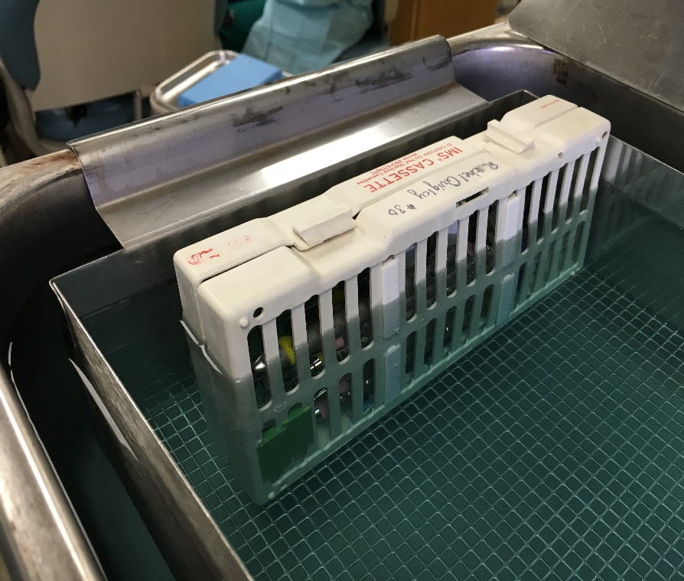
Automatic Cleaning
Ultrasonic –
Inexpensive & effective
Sound waves cause imploding bubbles to dislodge debris
De-gas, time, test, lid, no ties
Notes:
Degassing is the removal of large air bubbles found in all fresh solution, which act as a barrier to efficient cleaning. Degassing for 15 minutes (or IFU) is necessary every time new solution is added.
Foil test - Prepare fresh solution and fill tank.
Cut a piece of lightweight or regular aluminum foil to fit the width of the unit. If unit is 12 in long x 6 in wide x 5 in deep you would need a 12 x 6 piece of foil.
Place the foil vertically into the unit. It should run the full length of the unit and be about 1 inch from the bottom of the unit.
Turn the unit on high for 20 – 60 seconds.
Foil should have small uniform indentations throughout.
If areas greater than ½ inch show no indentations unit should be serviced.

Slide 41
Automatic Cleaning
Instrument washer/washer-disinfector
Not a dishwasher
Hot water and detergents to clean then dry cycle
Disinfecting cycle kills most microorganisms
Wrap and sterilize items

Slide 42
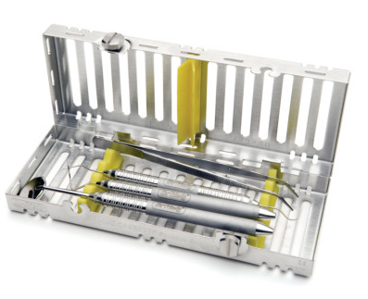
Preparation and Packaging
Hu-Friedy.com
Rinse and dry items
Visually inspect – reclean, replace
Package – in a container system or wrapping that is compatible with the type of sterilization
Hinged instruments open & unlocked
Chemical indicator in pack & if unable to see, on exterior too
Label pack with date, sterilizer #, load #, no H2O soluble ink
Notes:
When packaging most often you’ll use a peel pouch, rigid containers, woven or non-woven wraps.

Slide 43
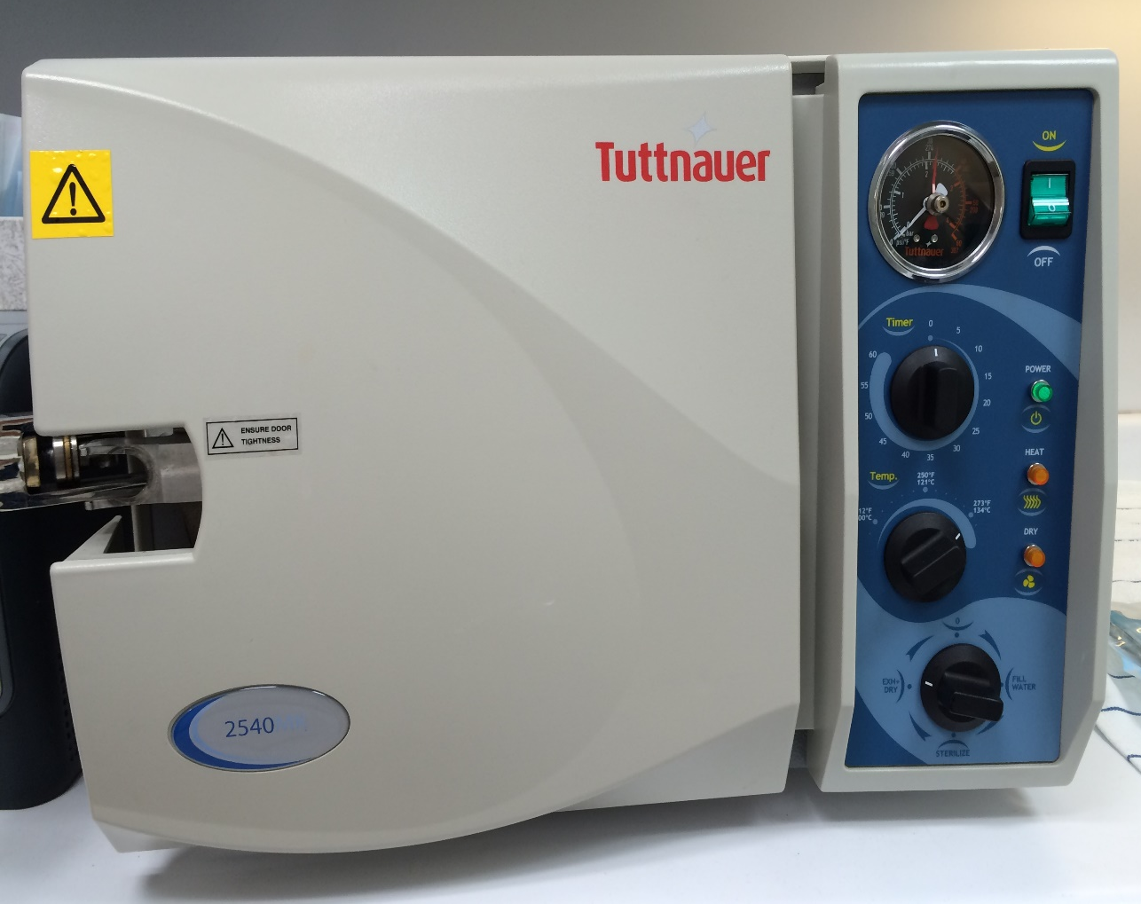
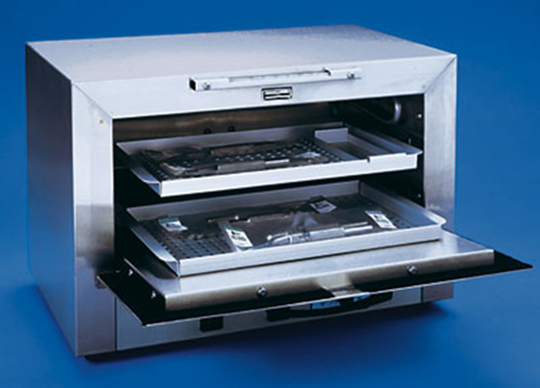
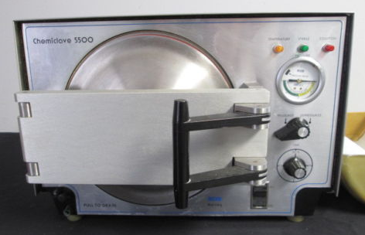
Notes:
Sterilization should be achieved with a FDA cleared medical device while following the manufacturer‘s instructions for correct use.

Slide 44
Sterilization Monitoring - Indicators
Mechanical – check cycle time, temp and pressure gauges
Chemical – 1 or 2 per pack to monitor time, temp and pressure
Biological – (BI/spore tests) cycle test by using heat resistant organisms called bacterial endospores
Use the correct spores/middle of load
Test min. weekly/maintain records
Verify done with every implantable device
Notes:
Physical - cycle time, temperature, pressure. Chemical - heat or chemical sensitive inks that change color when germicidal-related parameters reached.

Slide 45
Sterile Item & Clean Supply Storage
Items must be cool, clean and dry
Area is away from contamination
Store in covered or closed cabinets
Examine items reclean, repack and resterilize if needed
If a sterile pack falls on the floor, is it still considered sterile?
Notes:
Shelf life either time or event related. Time related – Remains sterile for an assigned period of time based on packaging type.
Event related – If stored appropriately and packaging intact safe for use indefinitely OR as stated by manufacturer.

Slide 46
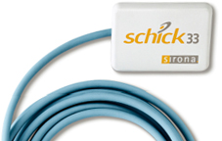
Dental Radiography
Digital Sensors
Cover with barriers (FDA/no Ziploc)
Clean and sterilize (or high-level disinfect) barrier protected semi-critical items between patients.
If unable, then clean and disinfect with an EPA registered intermediate level disinfectant

Slide 47
Environmental Infection Prevention & Control
DHCP are trained and use correct PPE
Written policies and procedures for cleaning and disinfection
Consistent use of barrier protection on difficult to clean areas or clean and disinfect clinical contact areas with intermediate EPA-registered hospital disinfectant
Use detergents based on the label claims (e.g. Tb)
Always follow the manufacturers IFU for use
Notes:
Clinical contact surfaces touch instruments, devices, hands or gloves. Housekeeping surfaces are not directly touched during delivery of care and include
Equipment, furniture, walls + floors = Low disease transmission risk

Slide 48
Dental Unit Water Quality
Lines become colonized with microorganisms that form biofilm, slough off and contaminate water
Design, flow rate & small diameter of unit tubing are factors/after 5 days new tubing 200K CFU/ml
Use water that < 500 CFU/ml heterotrophic bacteria per the EPA for routine dental treatment
Use sterile water for surgical coolant/irrigant
Follow CDC guidelines for a boil water advisory
Notes:
.

Slide 49
Infections in the News
Notes:
A child in late September after surgery for a Mycobacterium Abcessus dental infection she contracted in Anaheim, Calif. She had three permanent teeth, one baby tooth and part of her jawbone removed. In 2015 there was a Lymphadenitis outbreak in Jonesboro, Georgia. An 82 year old woman died of Legionnaires’ disease in Italy 2012

Slide 50
Water Monitoring Options
Maintain and monitor water quality by following the dental unit manufacturer and/or waterline treatment product IFU
Testing options -
Water testing laboratory
In-office test with self contained kits
Be sure to document results

Slide 51
Thank you!
Joyce A. Moore RDH, BSDH
Compass Dental Safety
Compassdentalsafety@gmail.com

